Slide 1
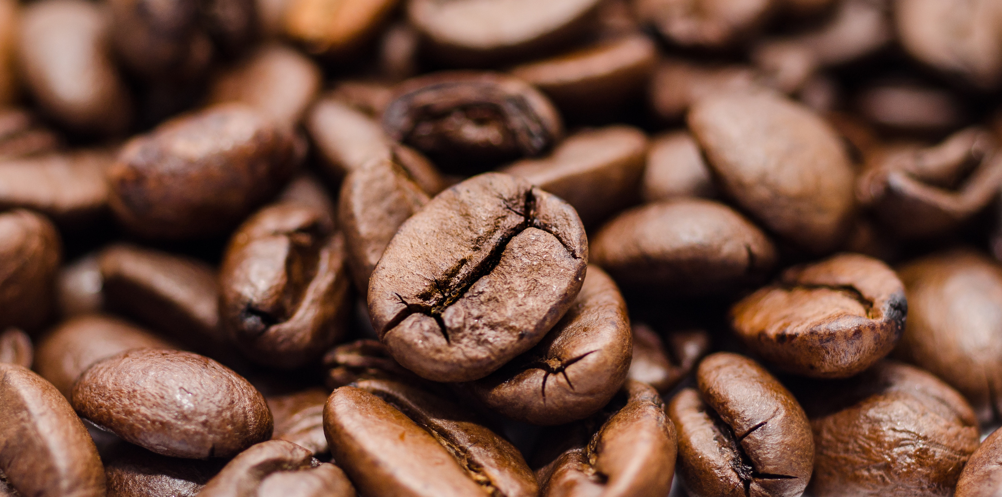
BRIGHT COFFEE SHOP ANALYSIS
Presentation By
Kabelo Tsitsing
Junior Data Analyst

Slide 2
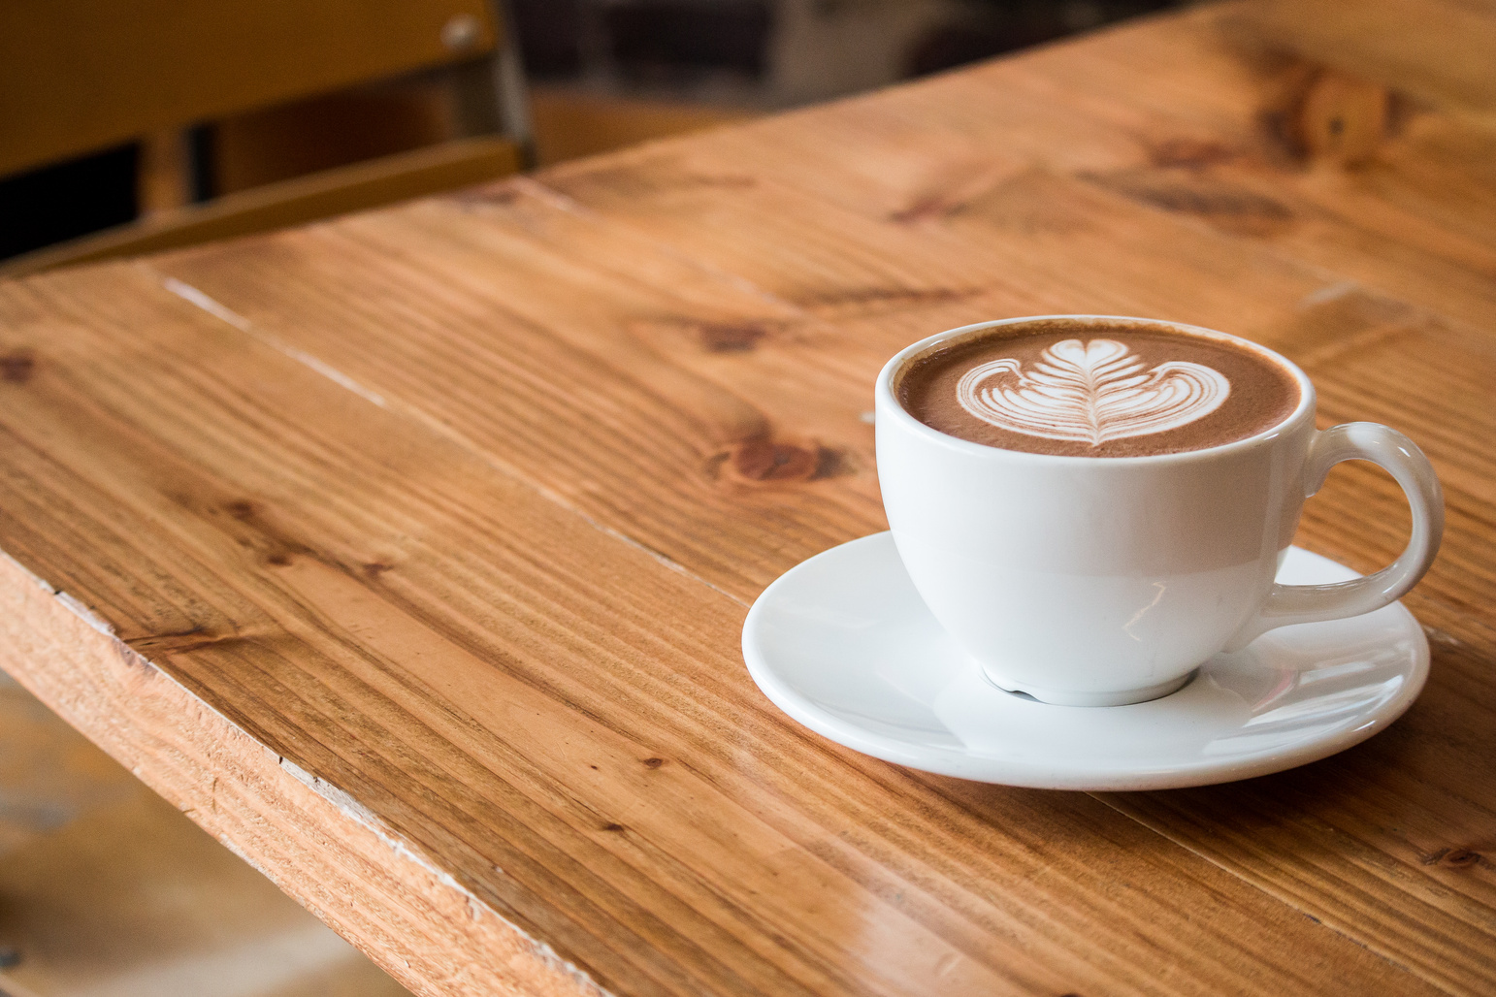
objective
TO PROVIDE INSIGHTS THAT WILL ASSIST THE COMPANY TO GROW THEIR REVENUE AND IMPROVE PRODUCT PERFORMANCE IN THREE DIFFERENT STORE LOCATIONS

Slide 3

INDEX
Project History
Coffee shops trends in three different store location
Analysis
Recommendations
Conclusion

Slide 4
PROJECT BACKGROUND
The data collected was between three stores namely Astoria, Hells Kitchen and Lower Manhattan; Retail Coffee Shops for the last 6 months
Astoria | 33.93%
Hell's Kitchen | 34.02%
Lower Manhattan | 32.04%
Total Sales of all products between each shop for the last 6 months
.

Slide 5
Retail Coffee Trends in all Three Stores
.
Coffee (39%) and Tea (28%) remain the most bought product category across all stores and least sold is Packaged Chocolate selling only 1% across the three stores
The product Category’s all differ based on product detail therefore meaning there are various category under each product

Slide 6
Monthly Sales Analysis
JANUARY 15%
FEBRUARY 13%
MARCH 16%
APRIL 17%
MAY 19%
JUNE 19%
The first three months had no consistent growth revenue as it decreased by 2% at February. From March to June there was 3%-6% increase in sales and the change of season might have been a driving factor as more products were sold

Slide 7
Peak Hours of the Coffee retail shops
Product Sales were twice as many as total Sales during the evening.
The low retail sales in the evening can be attributed to the time of operation of business or people are not willing to buy product category in the evening

Slide 8
Top 5 selling product details and the worst 5
Coffee is a drink prepared from roasted coffee beans. Darkly colored, bitter, and slightly acidic, coffee has a stimulating effect on humans, primarily due to its caffeine content. It has the highest sales in the world market for hot drinks.
Top 5 most selling product detail
Barista Espresso
Hot Chocolate
Brewed Black Tea
Brewed Chai tea
Brewed Herbal Tea
Top 5 worst selling Product detail
Green Tea
Espresso Beans
Black Tea
Driniking Chocolate
Green Beans
Exclusive template ready to be customized for your presentation.

Slide 9
Recommendations
Target Days and Months where retails sales were significantly low and introduce discounts during those periods
Replicate success factors stock more products that sells the most
Introduce Combo deals on product details that sells the least
Have customer surveys to understand more of what the customer needs leading to more improvised input
Promote time limited offers using digital signage or mobile app
Partner with local business to offer group discounts or loyalty rewards

Slide 10
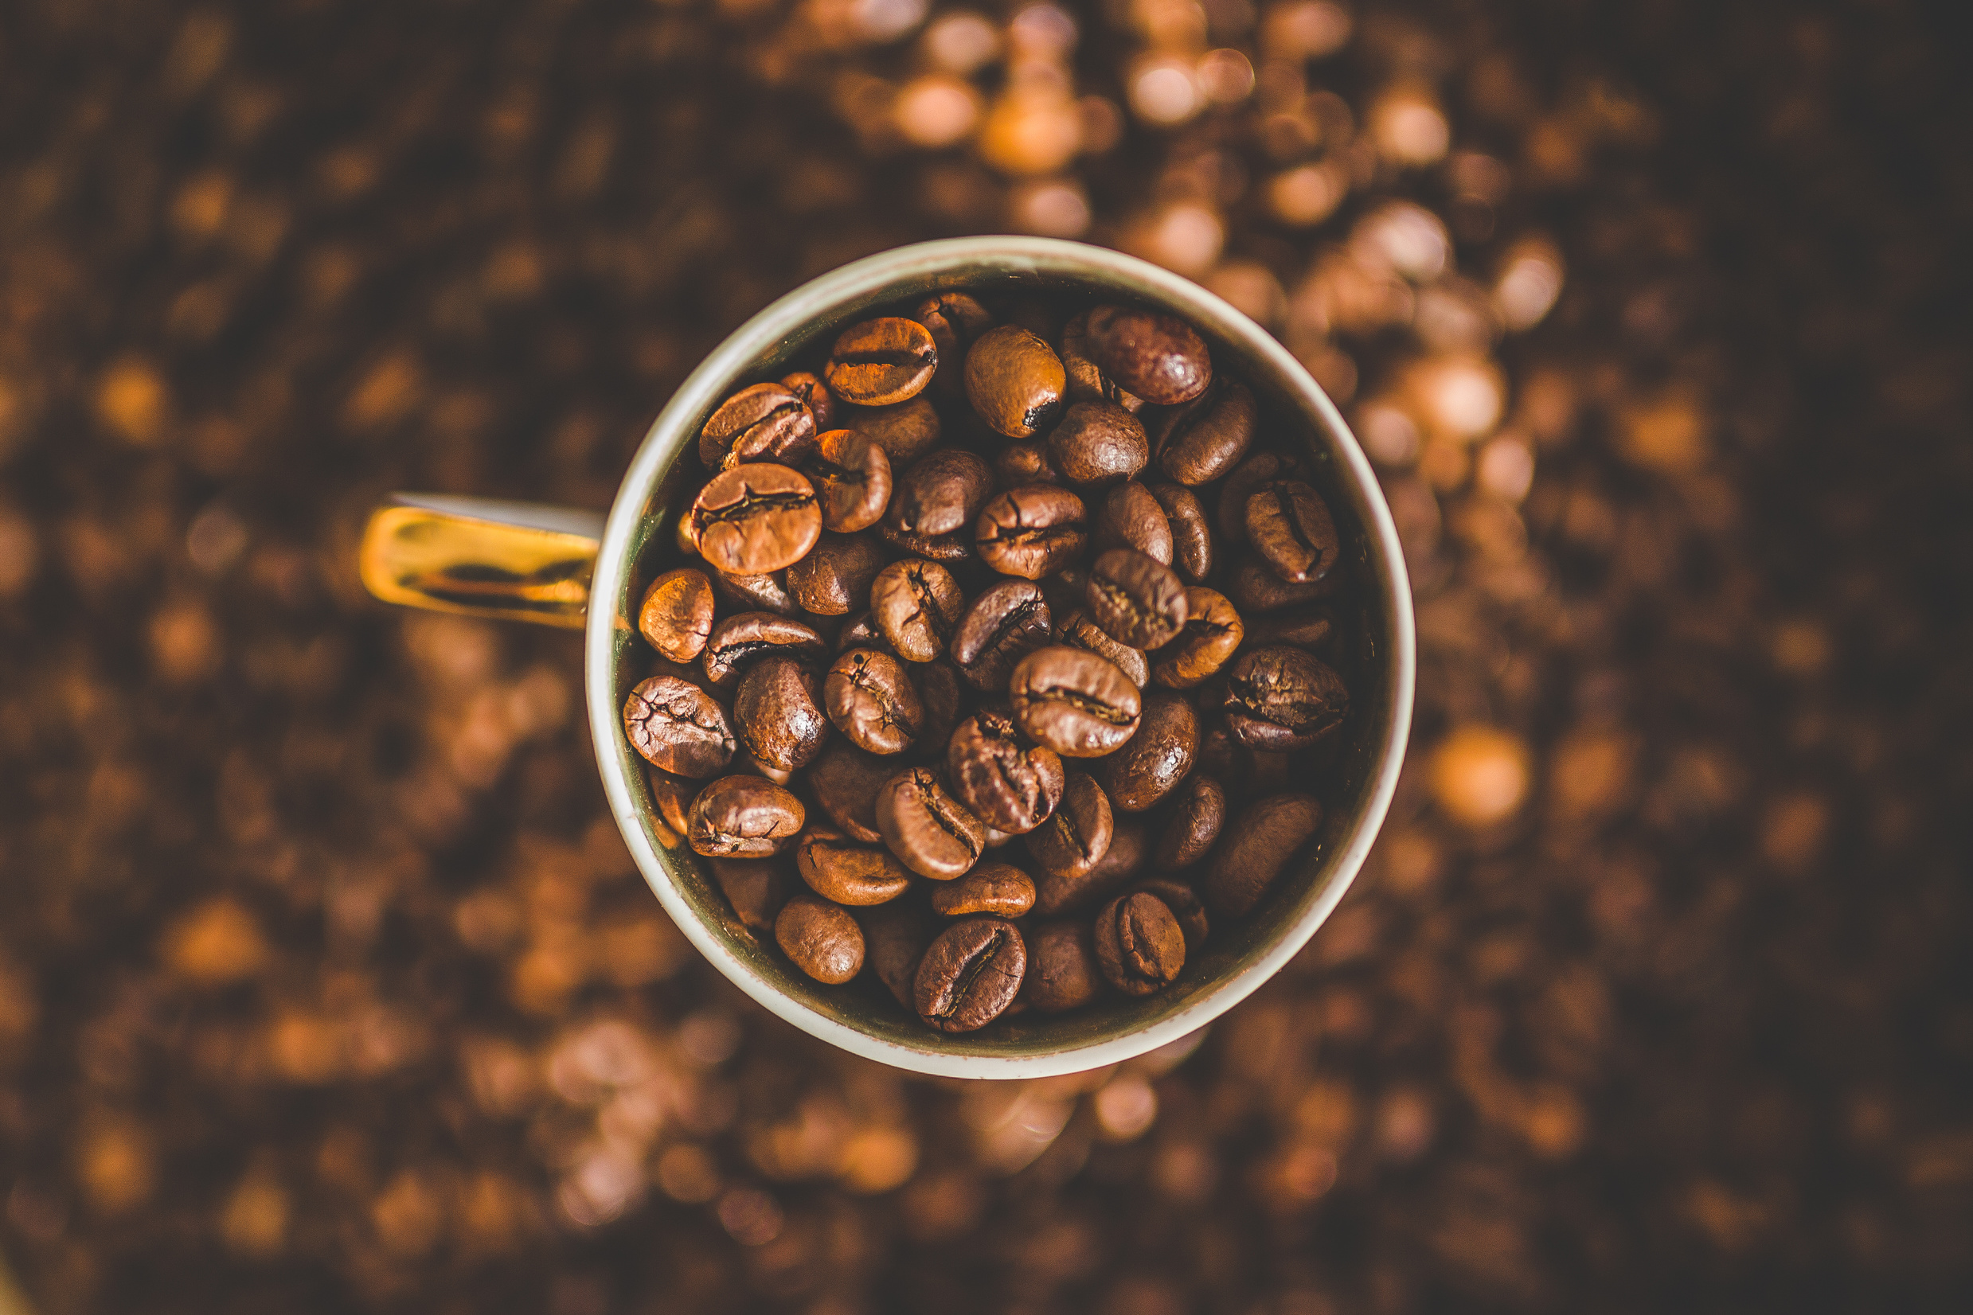
Thank you

